Slide 1

Java Programming Essentials: A Comprehensive Journey into Core Java and Beyond
- Bharath Ashok

Slide 2

Day 11

Slide 3
Day 11: Agenda
Set and Implementation Classes
HashSet
LinkedHashSet
Queue
Hands-on
Assignments
Interview Questions

Slide 4
Collection Framework

Slide 5
Set Interface

Slide 6
Java.util.Set
In Java, the Set interface is a part of the Java Collections Framework and represents a collection that does not allow duplicate elements.
The Java Collections Framework includes several classes that implement the Set interface, such as HashSet, LinkedHashSet, and TreeSet.
No Duplicate Elements: A Set does not allow duplicate elements. Each element in a Set must be unique based on the element's equals() method.
Unordered Collection: The elements in a Set are not stored in a specific order, unlike a List or an array. The order of elements may vary depending on the specific implementation.
Implements Collection: The Set interface extends the Collection interface, which means that it inherits the methods defined in Collection. This includes methods for adding, removing, querying, and manipulating elements.
Common Methods:The Set interface defines common methods such as add(), remove(), contains(), size(), and more. These methods are used for working with elements in the set.

Slide 7
Java.util.Set
Subinterfaces and Implementations:
Some common implementations include:
HashSet: Uses a hash table for fast insertion, deletion, and retrieval of elements. Does not guarantee order.
LinkedHashSet: Maintains the insertion order of elements while offering fast retrieval.
TreeSet: Maintains elements in sorted order. Implements a self-balancing binary search tree.
Null Elements: Most Set implementations do not allow null elements. However, some implementations like HashSet allow a single null element.
Use Cases: Set implementations are useful in scenarios where you need to store a collection of elements without duplicates. They are suitable for tasks such as maintaining a list of unique items, checking membership, and ensuring data integrity.

Slide 8
Implementation of Set Interface
HashSet:
Implemented using a hash table.
Offers constant-time performance for basic operations (add, remove, contains).
Does not guarantee order of elements. Allows a single null element.
Well-suited for scenarios where you need a fast and efficient set of unique elements.
Example: Removing duplicates from a collection.
LinkedHashSet:
Implemented as a hash table with a linked list running through it.
Maintains the insertion order of elements.
Offers constant-time performance for basic operations.
Useful when you want to maintain insertion order while still having fast access.
TreeSet:
Implemented as a self-balancing binary search tree (Red-Black Tree).
Maintains elements in sorted order.
Offers logarithmic-time performance for most operations.
Suitable for scenarios where you need elements to be sorted and ordered.
Example: Maintaining a sorted set of timestamps.

Slide 9
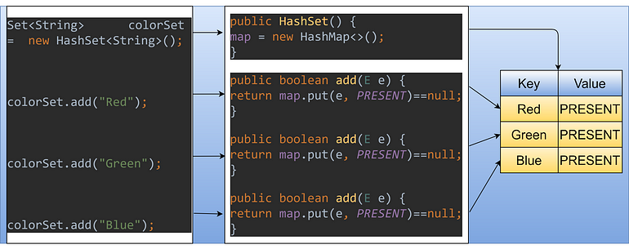
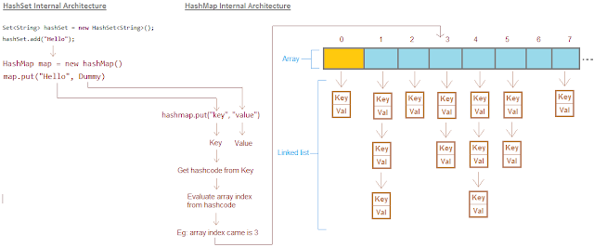
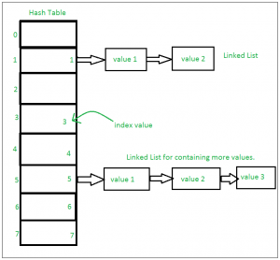
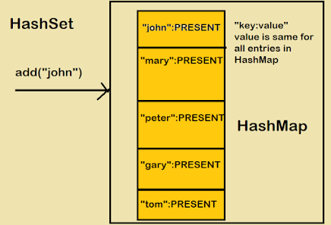
HashSet Internal Working

Slide 10
HashSet Internal Working
import java.util.HashSet;
public class HashSetExample {
public static void main(String[] args) {
HashSet<String> hashSet = new HashSet<>();
hashSet.add("Apple");
hashSet.add("Banana");
hashSet.add("Orange");
hashSet.add("Grapes");
hashSet.add("Pear");
System.out.println("HashSet: " + hashSet);
}
}
Output:
HashSet: [Banana, Grapes, Orange, Pear, Apple]
Insertion:
"Apple": Hash code = 65 + 112 + 112 + 108 + 101 = 498. Hash code % 10 (bucket count) = 8. Placed in bucket 8.
"Banana": Hash code = 66 + 97 + 110 + 97 + 110 + 97 = 577. Hash code % 10 = 7. Placed in bucket 7.
"Orange": Hash code = 79 + 114 + 97 + 110 + 103 + 101 = 604. Hash code % 10 = 4. Placed in bucket 4.
"Grapes": Hash code = 71 + 114 + 97 + 112 + 101 + 115 = 610. Hash code % 10 = 0. Placed in bucket 0.
"Pear": Hash code = 80 + 101 + 97 + 114 = 492. Hash code % 10 = 2. Placed in bucket 2.
Collisions:
In the example above, "Apple" and "Pear" have the same bucket index (bucket 8).
This is a collision. HashSet handles collisions by creating a linked list (or a tree in newer versions) in that bucket.
Similarly, "Grapes" and "Banana" end up in the same bucket (bucket 7), causing another collision.
Retrieval:
When you retrieve an element, the same hash code calculation and modulo operation are performed to locate the bucket.
The linked list (or tree) in the bucket is searched to find the desired element.

Slide 11
Java.util.HashSet
The HashSet is an implementation of the Set interface in Java's Collections Framework.
It is designed to store a collection of unique elements and provides fast and efficient operations for adding, removing, and checking for the existence of elements.
Key Characteristics:
Uniqueness of Elements: A HashSet does not allow duplicate elements. Each element in the set must be unique based on the element's equals() method.
No Guaranteed Order: The elements in a HashSet are not stored in any specific order. The iteration order of elements may vary depending on the specific implementation and the hash codes of elements.
Backed by Hash Table: Internally, a HashSet is backed by a hash table, which is an array of "buckets." Each bucket can hold one or more elements. The hash table uses hash codes to distribute elements across buckets.
Hash Function: The hash code of each element is used to determine the bucket in which the element should be placed. Java's hashCode() method is used to compute the hash code of an object.

Slide 12
Java.util.HashSet
Collisions Handling:
Since multiple elements may produce the same hash code (collision), HashSet handles collisions by using linked lists. Elements with the same hash code are stored in the same bucket in a linked list.
Performance Characteristics:
Basic operations (add, remove, contains) offer constant-time performance on average.
The actual performance may degrade in worst-case scenarios with many collisions, leading to linear time (O(n)) performance for some operations.
Dynamic Resizing (Load Factor):
HashSet dynamically resizes itself as elements are added. The load factor (default is 0.75) determines when the hash table should be resized to maintain efficient performance.
Null Elements:
HashSet allows one null element. If you attempt to add more than one null element, an IllegalArgumentException will be thrown.

Slide 13
Java.util.HashSet
Use Cases:
Removing Duplicates: HashSet is commonly used to eliminate duplicate elements from a collection while maintaining efficient performance.
Checking Membership: You can efficiently check whether a particular element is present in the set.
Storing Unique Values: It's useful for maintaining a collection of unique values, such as a set of user IDs or email addresses.

Slide 14
HashSet Hands-on

Slide 15
Java.util.LinkedHashSet
LinkedHashSet is an implementation of the Set interface in Java's Collections Framework.
It combines the features of both a HashSet and a LinkedHashMap, offering the benefits of a set (no duplicate elements) while also preserving the insertion order of elements.
Key Characteristics:
Uniqueness of Elements:
Like other Set implementations, a LinkedHashSet does not allow duplicate elements. Each element in the set must be unique.
Maintains Insertion Order:
LinkedHashSet maintains the order in which elements were added to the set. When iterating through the set, the elements are returned in the order they were inserted.
Combining Hash Table and Linked List:
Internally, LinkedHashSet uses a hash table to store elements, just like HashSet. However, it also maintains a doubly-linked list of all elements to preserve insertion order.
Performance Characteristics:
Basic operations (add, remove, contains) offer constant-time performance.
The iteration order of elements is the same as their insertion order, making it useful for scenarios that require ordered traversal.

Slide 16
LinkedHashSet Hands-on

Slide 17
Java.util.TreeSet
TreeSet is an implementation of the Set interface in Java's Collections Framework.
Key Characteristics:
Sorted Order:
Unlike a HashSet, a TreeSet maintains the elements in sorted (ascending) order according to their natural ordering or a custom comparator provided during initialization.
Balanced Tree Structure:
Internally, a TreeSet uses a self-balancing binary search tree to store its elements. This ensures efficient operations and maintains the sorted order.
Uniqueness of Elements:
Similar to other Set implementations, a TreeSet does not allow duplicate elements. Each element in the set must be unique based on the element's natural ordering or the comparator's rules.
Logarithmic Performance:
Most operations (add, remove, contains) take O(log n) time due to the balanced nature of the tree. Searching, insertion, and deletion have efficient time complexity.

Slide 18
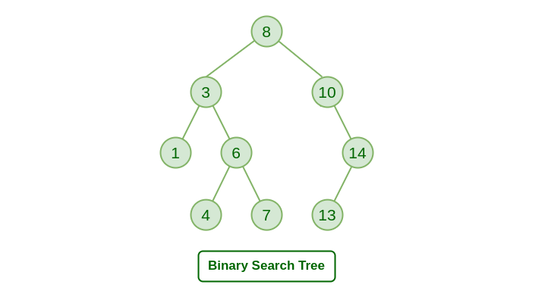
Binary Search Tree

Slide 19
Java.util.TreeSet
Navigational Operations:
TreeSet provides additional navigational methods such as lower, higher, floor, and ceiling, which allow you to find elements in relation to a given element.
Comparable or Comparator:
Elements added to a TreeSet must either implement the Comparable interface or be provided with a custom Comparator during initialization. This is used for establishing the sorting order.
Use Cases:
Sorted Data: When you need to maintain a sorted collection of elements without having to manually sort the elements each time.
Navigational Operations: When you need to efficiently find elements that are greater, lesser, or nearest to a specific value.
Unique Values: Like other sets, TreeSet maintains uniqueness of elements while offering.

Slide 20
TreeSet Hands-on

Slide 21
Queues

Slide 22
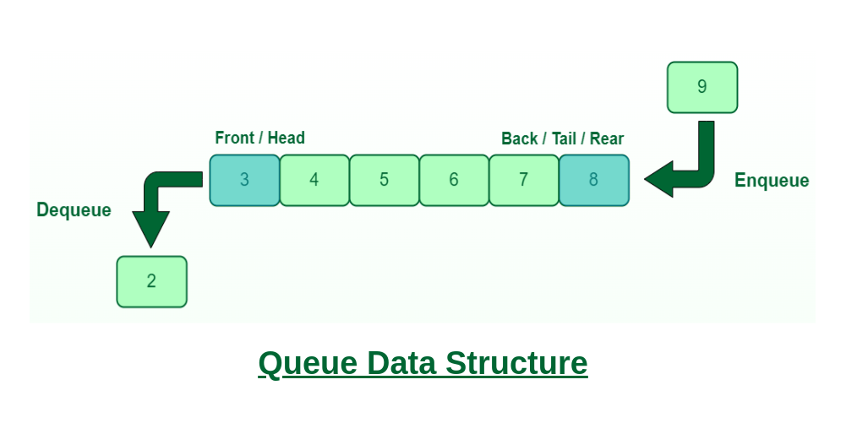
Introduction to Queues
Queues are a fundamental data structure in programming.
They follow the First-In-First-Out (FIFO) principle, where the first element added is the first one to be removed.
Queues are used to manage elements or tasks in a sequence, ensuring fairness in processing.

Slide 23
Java.util.Queue
Key Characteristics:
First-In-First-Out (FIFO):
The primary characteristic of a queue is that the element that is added first will be the first to be removed (hence, the term "first-in, first-out").
Operations:
Common operations on a queue include adding elements to the back (enqueue) and removing elements from the front (dequeue). Additionally, queues often provide methods to peek at the front element without removing it and to check if the queue is empty.
Interfaces:
In the Java Collections Framework, the Queue interface is the main interface that defines the operations of a queue. It extends the Collection interface and adds methods specific to queues.
Implementations:
LinkedList: A double-ended queue (Deque) that can be used as a queue.
ArrayDeque: A resizable-array implementation of a queue and deque.
PriorityQueue: A priority queue based on a heap data structure.
Blocking Queues: In addition to the basic Queue interface, Java also provides the BlockingQueue interface, which is an extension that includes methods for handling concurrency.
Blocking queues are designed to support multiple threads safely adding and removing elements.

Slide 24
Common Queue Implementations
LinkedList:
Unbounded queue implementation.
Offers flexibility and dynamic growth.
Commonly used for general-purpose queues.
PriorityQueue:
Orders elements based on priority (natural order or custom comparator).
Ideal for scenarios where priority matters.
ArrayBlockingQueue:
Bounded queue backed by an array.
Provides thread-safety.
Suitable for managing limited resources or concurrent tasks.

Slide 25
Queue Hands-on

Slide 26
Interview Questions

Slide 27
Set Interview Questions
What is the purpose of the Set interface in Java?
How does a Set differ from a List?
Name some classes in Java that implement the Set interface.
Explain the main characteristics of a Set.
What is the key property of elements within a Set?
Why is it important for elements in a Set to have appropriate hashCode() and equals() implementations?
Can a Set contain duplicate elements? Why or why not?
How is a HashSet implemented internally? What's its time complexity for insertion, deletion, and retrieval?
What is the purpose of the SortedSet interface? Provide an example of a class that implements it.
Describe the characteristics of a TreeSet. How does it maintain the order of elements?

Slide 28
Set Interview Questions
What is the significance of the NavigableSet interface? Name a class that implements it.
Explain the purpose of the HashSet class and how it handles collisions and hash codes.
How does the LinkedHashSet differ from the HashSet in terms of iteration order?
What is the primary benefit of using a LinkedHashSet over a HashSet?
How would you ensure that objects of a custom class can be properly stored in a HashSet?
What is the difference between HashSet and LinkedHashSet in terms of performance and use cases?
How can you synchronize access to a Set to make it thread-safe?
What is the time complexity for common operations in a HashSet and a TreeSet?
Explain the concept of a "power set." How could you generate it using the Set interface?
Describe a scenario where you might prefer using a HashSet over a TreeSet, and vice versa.

Slide 29
Set Interview Questions
How can you ensure that the elements stored in a HashSet remain in a consistent order?
Explain the difference between HashSet and LinkedHashSet in terms of memory usage.
What is the primary advantage of using a TreeSet over other set implementations?
How does the equals() method in the Set interface differ from the equals() method in the List interface?
Can you use a custom object as a key in a HashSet or a TreeSet? What requirements must the object meet?
Describe a scenario where you would use a HashSet to identify and eliminate duplicate elements in a collection.
How does a HashSet handle hash collisions? What mechanism is used to store colliding elements?
What are the key differences between a HashSet and a LinkedHashSet in terms of iteration order?
What is the relationship between the Set and Map interfaces in Java?
When iterating through a HashSet, does the order of elements remain the same between iterations? Why or why not?

Slide 30
Assignments

Slide 31
Set Assignments
Assignment 1: Frequency Count using HashSet
Build a program that takes a string as input and uses a HashSet to determine the frequency of each character in the string. Ignore spaces and punctuation. Display the character frequency in descending order.
Assignment 2: Social Network Connections
Design a system to manage social network connections. Implement a HashSet of User objects where each user has an ID and a list of friends' IDs. Create methods to add users, establish connections, and find mutual friends between two users.
Assignment 3: Vocabulary Builder
Construct a program that reads a text document and creates a vocabulary set of unique words. Use a TreeSet to automatically sort the words alphabetically. Implement methods to read from the file, add words to the set, and display the sorted vocabulary.

Slide 32
Set Assignments
Assignment 4: Shopping Cart
Create a shopping cart system using a LinkedHashSet to maintain the order of items added. Implement methods to add items, remove items, and display the items in the cart.
Assignment 5: Conference Scheduling
Build a conference scheduling system that uses a HashSet to store talks for a day. Each talk has a title, start time, and duration. Implement methods to add talks, ensure no overlapping talks, and display the schedule.
Assignment 6: Password Vault
Design a password vault using a HashSet to store encrypted passwords. Implement methods to add new passwords, check for password existence, and retrieve passwords.

Slide 33
Q&A

